Slide 1
Design patterns: The singleton Pattern
Bui Vu Khoa – 1042108
Pham Tuan Kiet - 1042103

Slide 2
Table of contents
Definition
What is multithreading
How Singleton interact with Multithreading
​Code showcase

Slide 3
Definition
Behavioral design pattern
Encapsulates and decouple
Allows the requester to specify a request via object

Slide 4
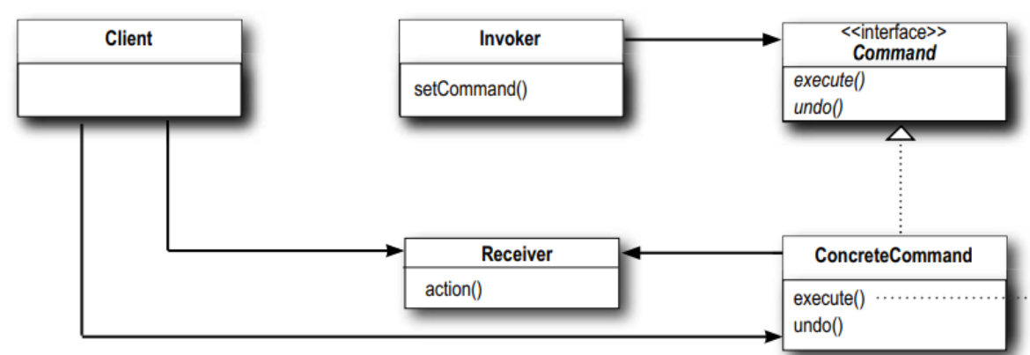
How it works
Receiver, Concrete Command and the Invoker

Slide 5




Use cases
parameterize objects with commands
support undo and redo operations
queue commands
log commands
for debugging purposes

Slide 6





Benefits
Decoupling
Extensibility
Rollback
Abstraction
Testing
Providing clear separation
Ease of component adding
Undo and redo made easier
Abstract details, simplifying code
Test individual commands in isolation

Slide 7

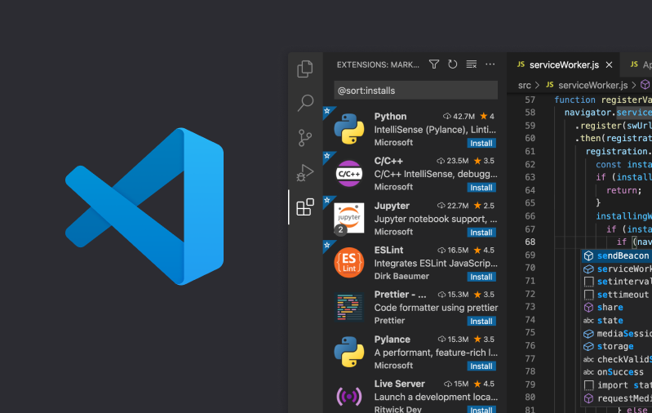
Real life examples

Slide 8
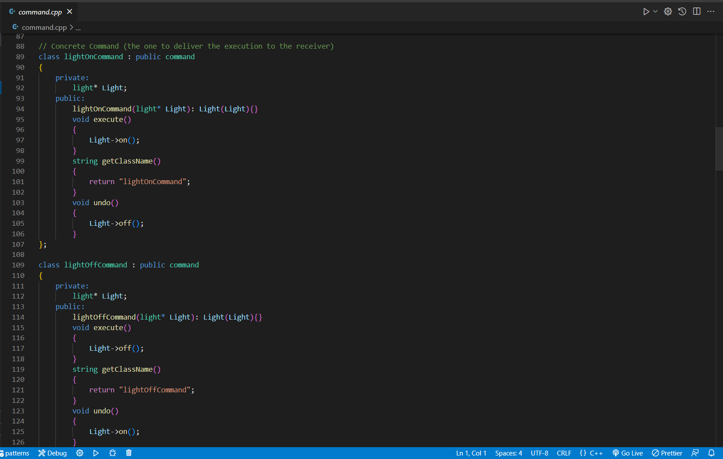
Code showcase

Slide 9








MEET OUR Extended TEAM
TAKUMA HAYASHI
MIRJAM NILSSON
FLORA BERGGREN​
RAJESH SANTOSHI​
President
Chief Executive Officer
Chief Operations Officer
VP Marketing
GRAHAM BARNES
ROWAN MURPHY
ELIZABETH MOORE
ROBIN KLINE
VP Product
SEO Strategist
Product Designer
Content Developer

Slide 10
TIMELINE
SEP 20XX
NOV 20XX
JAN 20XX
MAR 20XX
MAY 20XX
Synergize scalable e-commerce
Disseminate standardized metrics
Coordinate e- business applications
Foster holistically superior methodologies
Deploy strategic networks with compelling e- business needs

Slide 11
AREAS OF FOCUS
B2B MARKET SCENARIOS
CLOUD-BASED OPPORTUNITIES
Develop winning strategies to keep ahead of the competition
Capitalize on low-hanging fruit to identify a ballpark value
Visualize customer directed convergence
Iterative approaches to corporate strategy
Establish a management framework from the inside

Slide 12



HOW WE GET THERE
ROI
NICHE MARKETS
SUPPLY CHAINS
Envision multimedia-based expertise and cross-media growth strategies
Visualize quality intellectual capital
Engage worldwide methodologies with web-enabled technologies
Pursue scalable customer service through sustainable strategies
Engage top-line web services with cutting-edge deliverables
Cultivate one-to-one customer service with robust ideas
Maximize timely deliverables for real-time schemas

Slide 13
THANK YOU
Mirjam Nilsson​
mirjam@contoso.com
www.contoso.com

